Slide 1
Filtering in Frequency Domain

Slide 2
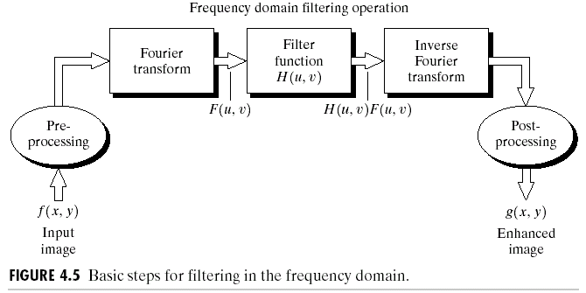
Basic Filtering in the Frequency Domain

Slide 3
Basic Filtering in the Frequency Domain
Multiply the input image by (-1)x+y to center the transform
Compute F(u,v), the DFT of the image from (1)
Multiply F(u,v) by a filter function H(u,v)
Compute the inverse DFT of the result in (3)
Obtain the real part of the result in (4)
Multiply the result in (5) by (-1)x+y

Slide 4
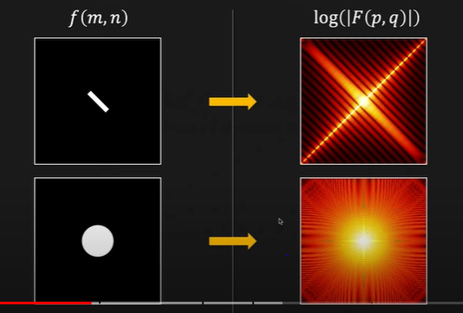
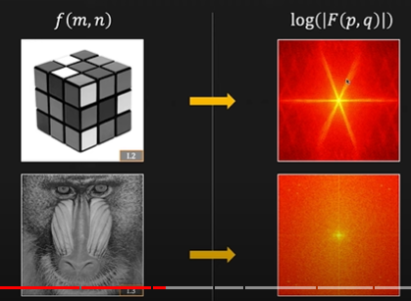
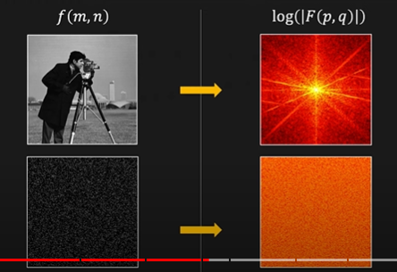
2D Fourier Transform Eg..

Slide 5
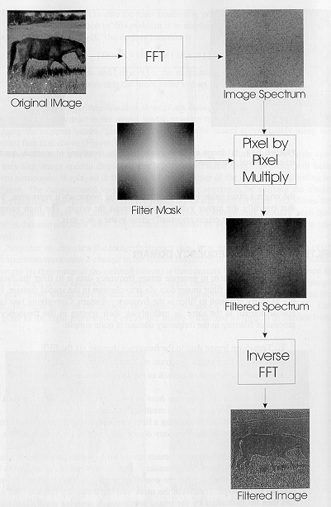
Basic Filtering in the Frequency Domain

Slide 6
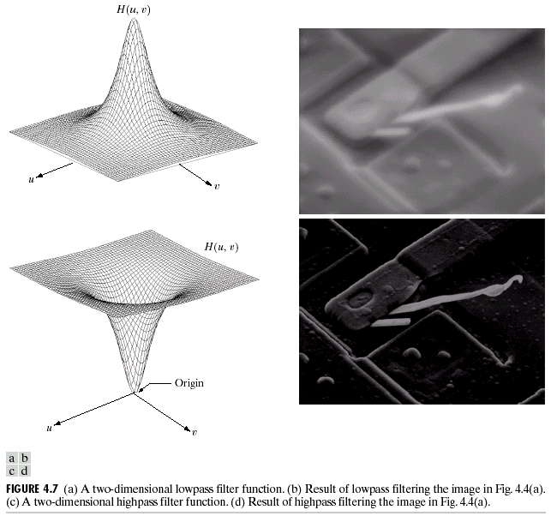
Low-pass and High-pass Filters
Low Pass Filter attenuate high frequencies while “passing” low frequencies.
High Pass Filter attenuate low frequencies while “passing” high frequencies.

Slide 7
Types of Filters in Frequency Domain
Ideal low/High-pass filter (ILPF/IHPF)
Butterworth low/High-pass filter (BLPF/BHPF)
Gaussian low/High-pass filter (GLPF/GHPF)

Slide 8
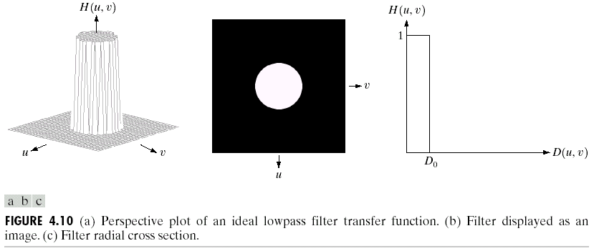
Ideal Low-pass Filters

Slide 9
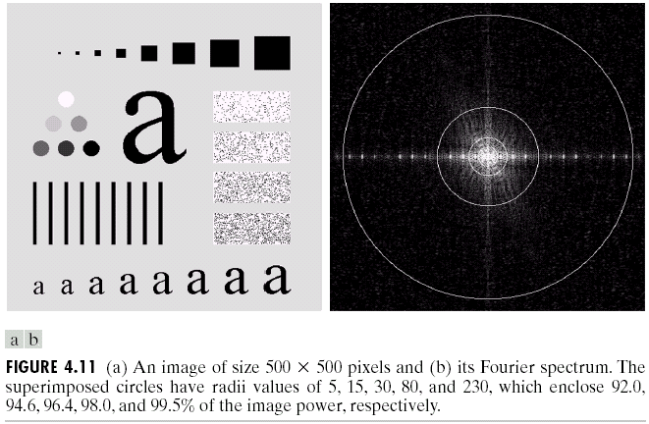
Ideal Low-pass Filters

Slide 10
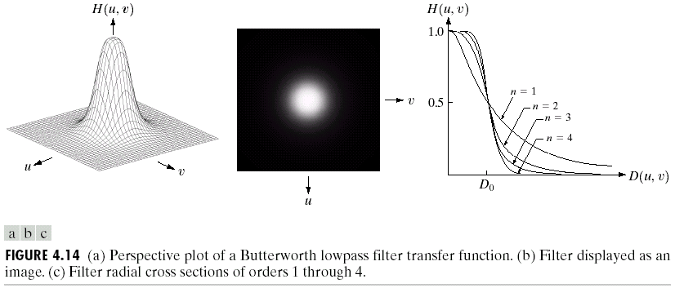
Butterworth Low-pass Filters

Slide 11
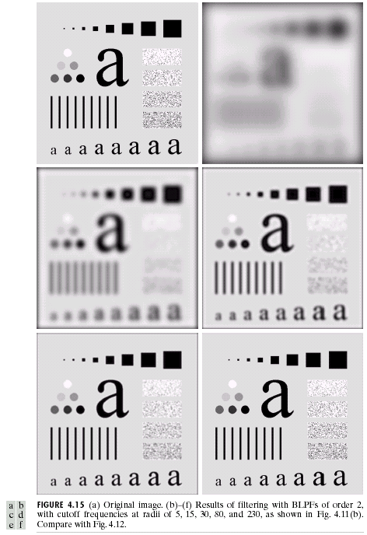
Butterworth Low-pass Filters

Slide 12
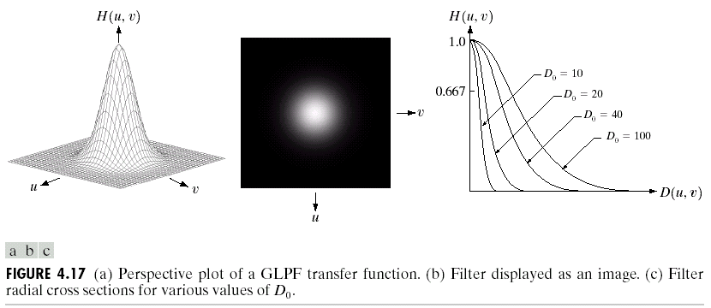
Gaussian Low-pass Filters

Slide 13
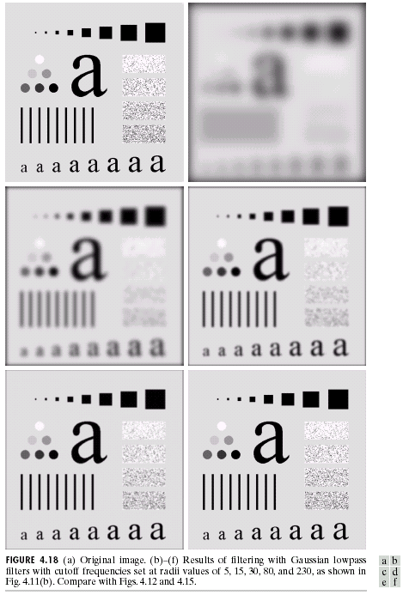
Gaussian Low-pass Filters

Slide 14
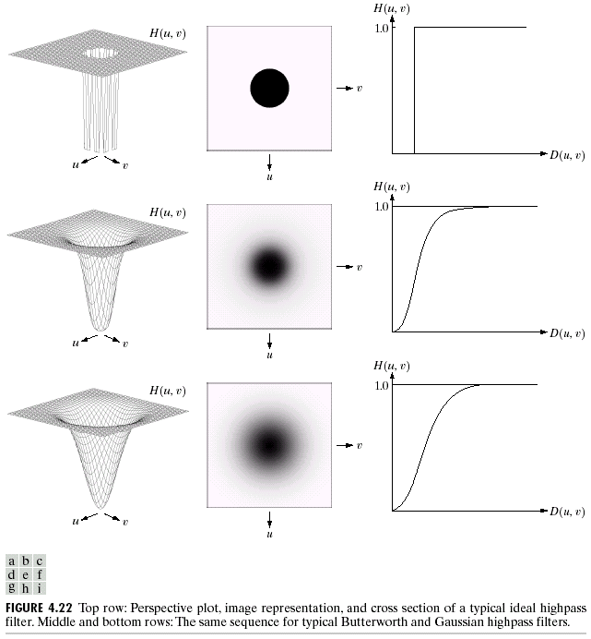
Sharpening Frequency Domain Filters
H_{hp}(u,v) = 1 - H_{lp}(u,v)

Slide 15
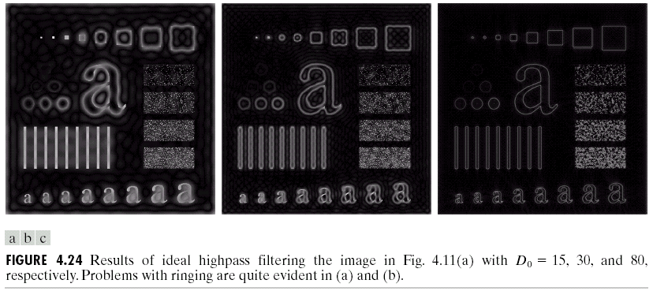
Ideal High-pass Filters

Slide 16
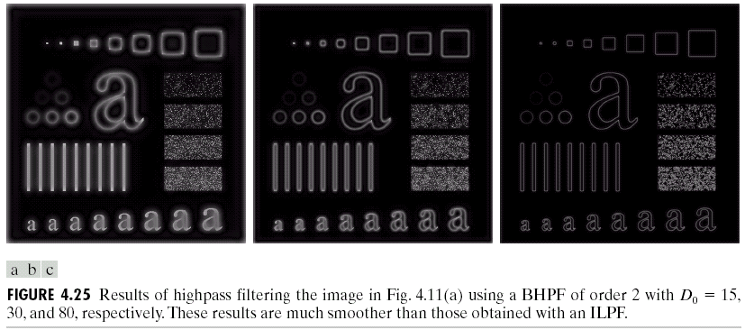
Butterworth High-pass Filters

Slide 17
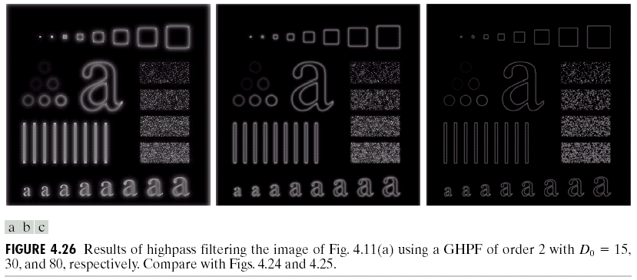
Gaussian High-pass Filters

